Slide 1


Thankyou
Working
Content
Features
Chart
Conclusion
Challenges
Cycles
Asyn-Logic
Introduction
Prob-Synchronous
Topic

Slide 2

Asynchronous chips
Thankyou
Working
Content
Features
Chart
Conclusion
Challenges
Cycles
Topic
Asyn-Logic
Introduction
Prob-Synchronous
BY SHUJA UR RAHMAN

Slide 3
INTRODUCTION
PROBLEMS WITH SYNCHRONOUS
Approach ASYNCHRONOUS LOGIC
HOW DO THEY WORK?
SOME FEATURES
A CHALLENGING TIME
CONCLUSION
CONTENT
Thankyou
Working
Content
Features
Chart
Conclusion
Challenges
Cycles
Topic
Asyn-Logic
Introduction
Prob-Synchronous

Slide 4
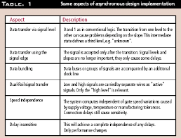
PROBLEM RELATED WITH SYNCHRONOUS CHIPS
Traverse the chip’s longest wires in one clock cycle.
Distributing the clock globally. | Order of arrival of the signals is unimportant.
Wastage of energy. | Clocks themselves consume lot of energy (~30%).
Thankyou
Working
Content
Features
Chart
Conclusion
Challenges
Cycles
Topic
Asyn-Logic
Introduction
Prob-Synchronous

Slide 5
Clockless chips/Asynchronous/self-timed circuits.
Functions away from the clock.
Different parts work at different speeds.
Hand-off the result immediately.
Thankyou
Working
Content
Features
Challenges
Conclusion
Chart
Asyn-Logic
Topic
Cycles
Introduction
Prob-Synchronous

Slide 6
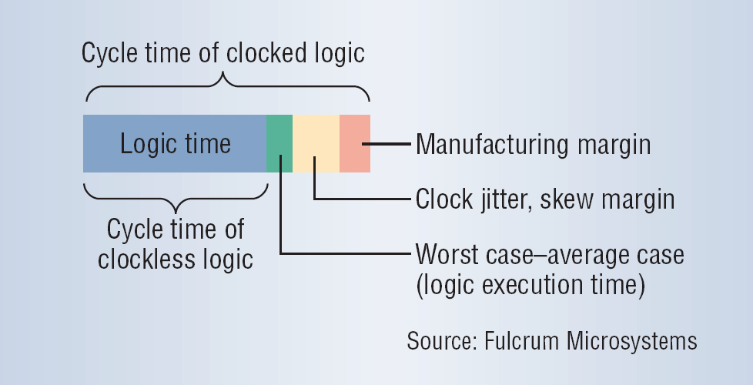
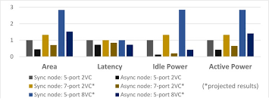
Thankyou
Working
Content
Features
Challenges
Conclusion
Chart
Asyn-Logic
Topic
Cycles
Introduction
Prob-Synchronous

Slide 7

Thankyou
Working
Content
Features
Challenges
Conclusion
Chart
Topic
Asyn-Logic
Cycles
Introduction
Prob-Synchronous

Slide 8
HOW DO THEY WORK?
No pure asynchronous chips are available.
Uses handshake signals for the data exchange.
Data moves only when required, not always.
Minimizes power consumption.
Less EMI ⇒ less noise ⇒ more applications.
EMI=Electromagnetic Interference
Thankyou
Features
Working
Content
Challenges
Conclusion
Chart
Topic
Asyn-Logic
Cycles
Introduction
Prob-Synchronous

Slide 9
Integrated pipelining mode.
Domino logic.
Delay – insensitive.
Two different implementation details
Dual rail.
Bundled data.
Thankyou
Working
Content
Challenges
Features
Conclusion
Chart
Topic
Asyn-Logic
Cycles
Introduction
Prob-Synchronous

Slide 10
CHALLENGES
Interfacing between synchronous and asynchronous
Many devices available now are synchronous in nature.
Special circuits are needed to align them.
Lack of expertise.
Lack of tools.
Engineers are not trained in these fields.
Academically, no courses available.
Thankyou
Working
Content
Features
Conclusion
Challenges
Chart
Topic
Asyn-Logic
Cycles
Introduction
Prob-Synchronous

Slide 11
Clocks have served the electronics design industry very well for a long time, but there are insignificant difficulties looming for clocked design in future. These difficulties are most obvious in complex SOC development, where electrical noise, power and design costs threaten to render the potential of future process technologies inaccessible to clocked design.
Link: MORE ABOUT ASYNCHRONOUS CHIPS
CONCLUSION
Thankyou
Working
Content
Features
Challenges
Conclusion
Chart
Topic
Asyn-Logic
Cycles
Introduction
Prob-Synchronous

Slide 12
THANKYOU
Thankyou
Working
Content
Features
Challenges
Conclusion
Chart
Topic
Asyn-Logic
Cycles
Introduction
Prob-Synchronous

